Slide 1
Using Machine Learning to develop Short term Trend Trading Strategies
Ricky Sambo MACHARM
3rd May 2021

Slide 2
Group # 9
Ricky Sambo MACHARM

Slide 3
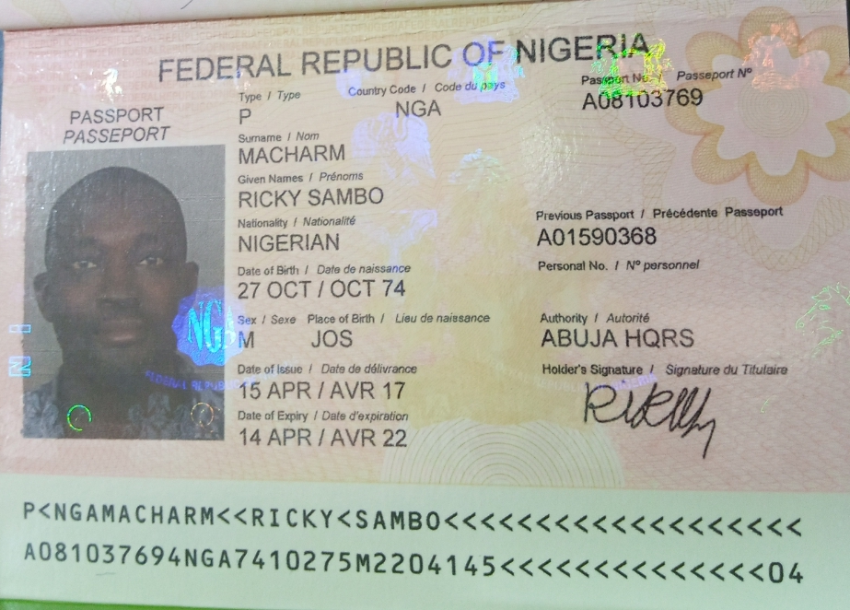
Government Issued Photo ID

Slide 4
Project Goal and Importance
This project aims at leveraging on the power of Python to create a standalone signal generating web app for the FOREX market.
This project aims to build make the rising traders anywhere in the world to have access to a signal generating webapp that could assist them in their trading decisions.
It would grow to also include other markets like stocks, ETFs and Crypto currencies

Slide 5
Literature Review/Background
T. Crabel, Day trading with short term price patterns and opening range breakout. Greenville, SC: Traders Press, 1990.
Y. J. Hilpisch, Artificial intelligence in finance: a Python-based guide. Sebastopol, CA: O’Reilly Media, 2021.
X. Wang, P. Kang, H. Phua, and W. Lin, “Stock market prediction using neural networks: Does trading volume help in short-term prediction?,” 2003.

Slide 6
Literature Review/Background
Contribution to the knowledge base within the field
A practical project
To get more people to get familiar with python for algorithmic trading

Slide 7
Assumptions and Choice of Technology
The following points are the assumptions made in developing this project.
The users are familiar with risk management
Folks will warm up and begin to use the webapp

Slide 8
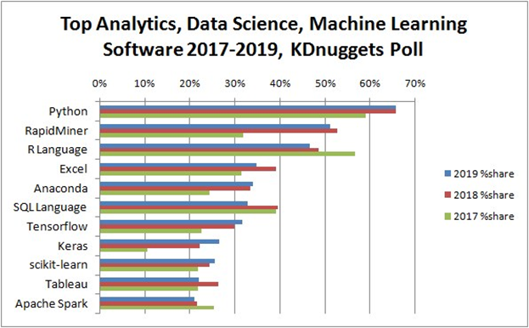
Assumptions and Choice of Technology
Choice of software/programming language used
Python has loads of free open source projects on github that could be quickly adapted to solve most problems; huge user community.
Image source: KDnuggets

Slide 9
Assumptions and Choice of Technology
Choice of software/programming language used
Oanda API
Free for downloading past data for backtesting

Slide 10
Peer Review Feedback
Discuss how you implemented the critical feedback you received from the peer review
Back testing
Train, Validation, and Test sets used
Pyfolio Python packages used to analyze backtested results
Clear presentation.
More annotated diagrams

Slide 11
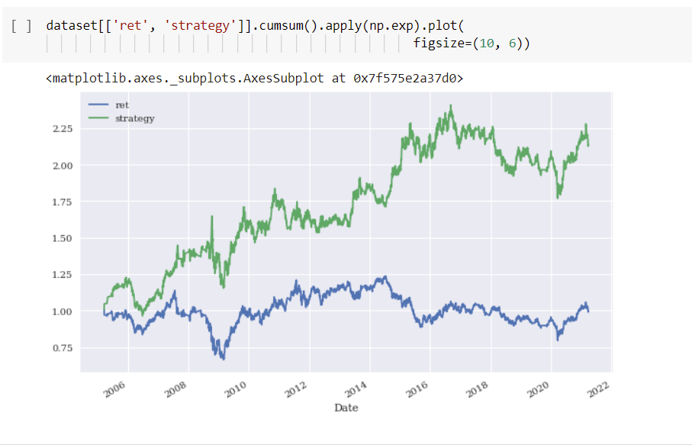
Summary of Results
Present your overall results and findings, with at least one (1) specific example.

Slide 12
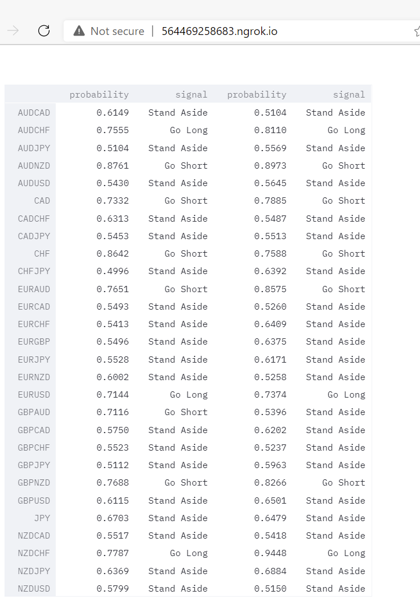
Summary of Results
Present your overall results and findings, with at least one (1) specific example.

Slide 13
Summary of Results
I was able to meet my goal of training and deploying a trading algorithm on a standalone webapp.
My contribution is attempting to bring Python for Algorithmic trading to the mainstream for non-coders
I learnt to work under a lot of pressure to meet up since I was working alone. I also learnt to use packages I never used before. I also learnt that there are so many thing I could do with Python that I was previously unaware of.

Slide 14
Your Contribution
Since it was a solo project it means I carried out the entire research, wrote the codes tested them, discarded those I couldn’t use and deployed the final results onto the webapp.

Slide 15
Conclusions
Machine Learning in the past have been shown to outperform buy-and-hold strategy for a number of trading instruments
We were able to achieve the same in this project
Since we can easily deploy our algorithms as a webapp we can also get ordinary traders to benefit from the use of Machine Learning in making trading decisions
Being able to do so from a basket of currency pairs will give a simple trader an edge in the markets.

Slide 16
Future Scope of Work
More trading instruments can be incorporated
Paid hosting services will be employed to enable the project get more traffic
Other research papers would be tested and deployed if found useful
The project will welcome open source contributors on the github repo.
GitHub repo: https://github.com/African-Quant/WQU_MScFE_Capstone_Grp9

Slide 17
Thank you WQU

